Slide 1
Authorship Attribution on Twitter: A Comparative Methods Study
Author: Julian Griggs
Class: 2015
Advisor: Andrea LaPaugh

Slide 2

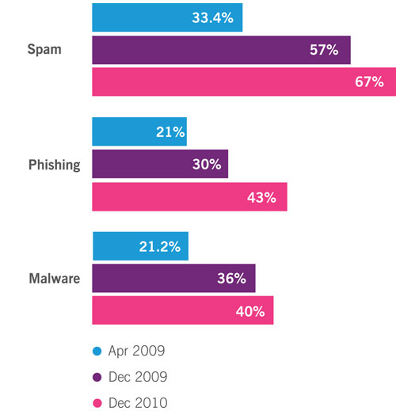
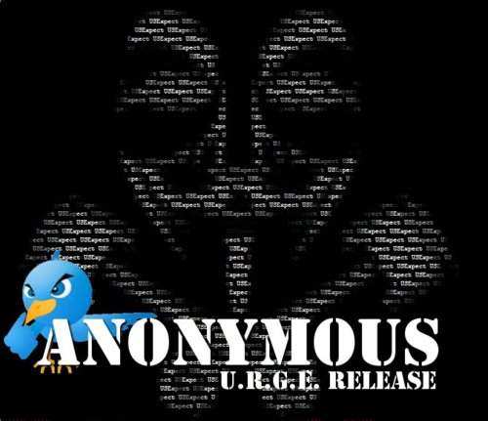

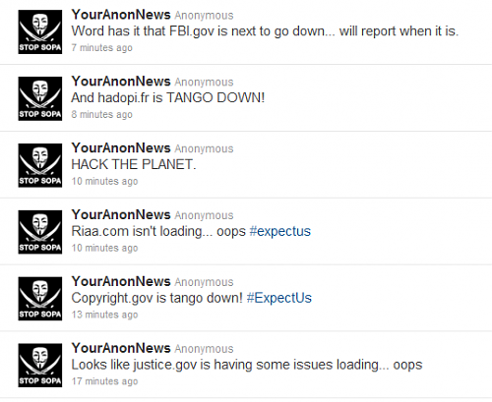

Slide 3
Motivation
Increasing amount of crime being arranged or discussed on social media platforms¹
Phishing, cyberscams, identity theft
Marketing malware, pornography, copyrighted materials
Pseudonymity + anonymity network = Impossible to find?
Stylometric techniques can help in determining authorship
¹Authorship Attribution for Twitter in 140 Characters or Less

Slide 4
Existing Research
Highly explored uses of Statistical Stylometry (Long works)
Academic Papers
Novels
Emails
Blogs
Types of Algorithmic Methods Used:
Writeprints (average sentence length, average word length, use of function words, vocabulary richness)
Neural Networks
K-Means and Support Vector Machines
Some exploration into use with Twitter
Source Code Authorship Profile (Using Character N-Grams)
K-Signatures
Notes:
Federalist Papers – Madison, Hamilton, John Jay
K Signatures- these are features that appear in at least k% of an author’s training set data while not appearing in the training set of any of author. These are typical of many authors

Slide 5
Relationship to My Research
I want to determine which methods work best with Twitter data
How does prediction accuracy change with number of tweets in training and test sets
Previous, research uses random Twitter Users,
Test methods on categorically chosen users
Contribute to open source J-Stylo project

Slide 6
Plan of Attack
Gather and store data
Random data set gathered ideally from a previous research group
Categorical tweets will need to be mined
Dig into research
Gain understanding of the different algorithms available
Focus on those best suited for Twitter- style data
Format data appropriately. To keep or to remove?
Twitter replies
URL’s
Hashtags

Slide 7

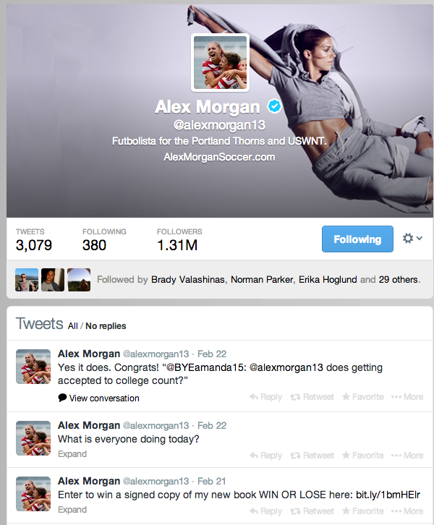
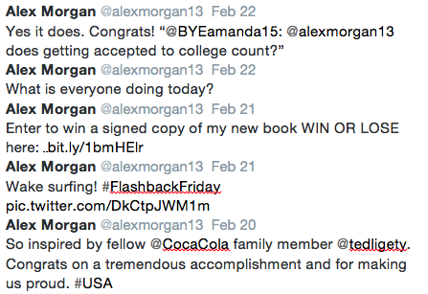
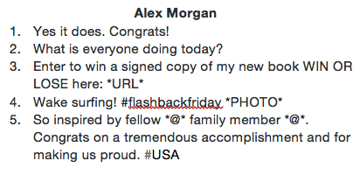
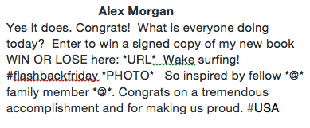

Slide 8
Dates/Deadlines
Now – March 13th: Gather all the tweet data. (Existing data set, and newly gathered set)
March 6 – March 20: Heavy background research, begin writing background section of paper
March 20 – March 27: Begin testing existing stylometric techniques on dataset using Jstylo
March 27 – April 3: Implement / find implementations of additional techniques (Hopefully incorporate them into open source J-Stylo or JGAAP)

Slide 9
Dates/Deadlines
April 3 – April 10: Test additional methods
April 10 – April 17: Organize results
April 17 – April 28: Write first draft
April 28 – May 4: Write second draft
May 5: Cinco de Mayo

Slide 10
Evaluating Success
Conclusively determine which techniques, if any, are effective at determining authorship for Twitter data
Conclusively determine how well these same techniques work in the case of determining authorship between people in similar domains
Basic testing: Training set, Testing Set
K-Fold cross validation to get the most mileage from the data

Slide 11
Summary
Comparative study of stylometric techniques as applied to Twitter data
Will provide new insight into application of stylometry to micro-posts(individual vs. aggregated)
Data retrieval component – Gathering the data
Could lead to important future studies / discoveries
Cross referencing tweets with chat-room, text messages, etc.

